Slide 1
View Resolver
Top class quick overview

Slide 2
Implementations
AbstractCachingViewResolver
BeanNameViewResolver
ContentNegotiatingViewResolver
ViewResolverComposite
ModelExposingViewResolver
StaticViewResolver
TestViewResolver
ModelValidatingViewResolver

Slide 3
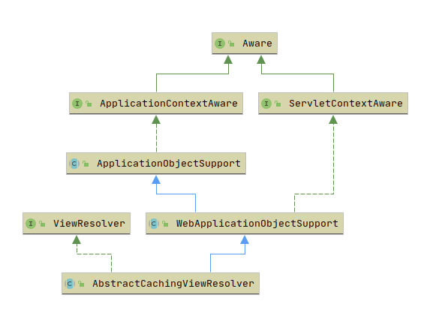
AbstractCachingViewResolver
Inherit from Sping Web
Cache the ViewName - View mapping
Support multithreading
Note

Slide 4
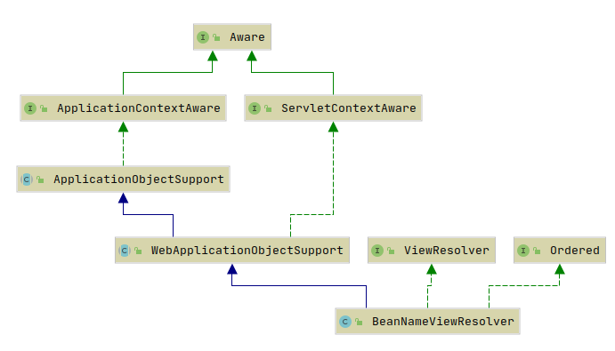

BeanNameViewResolver
Map ViewName to Bean
Specify the priority by order
Example

Slide 5
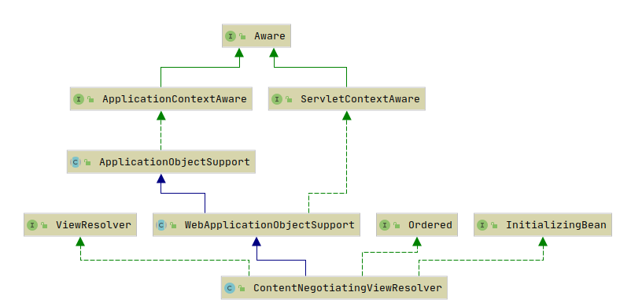
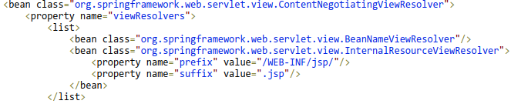
ContentNegotiatingViewResolver
Delegate views to other viewResolvers
Highest order
Use file extension or http header to specify the file type
Might return multiple candidate views
Example

Slide 6
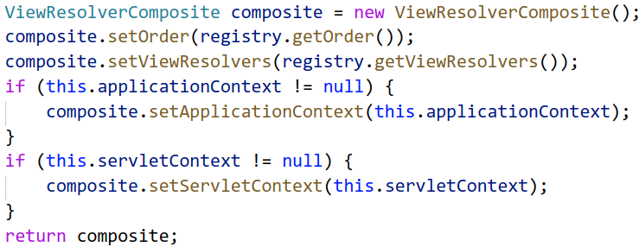
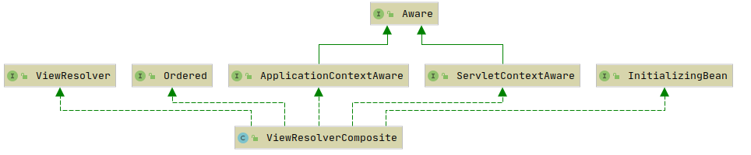
ViewResolverComposite
Pack all ViewResolver together
Used in WebMvcConfigurationSupport

Slide 7
External
Class
WebApplicationObjectSupport
Interface
ApplicationContextAware
ServletcontextAware
Ordered
InitializingBean

